Slide 1
Convolutional Neural Networks (cNN)
A summary of Chapter 9 in “Deep Learning” by goodfellow et al.
Ivan-Louis M. Husebø, 7. march

Slide 2
Plan
Explain convolutions
Why does cNNs work?
Pooling
Convolution in NN
The difference in convolution in engineering/mathematics
Different variants
Algorithms
Output control
Features
History
Examples

Slide 3
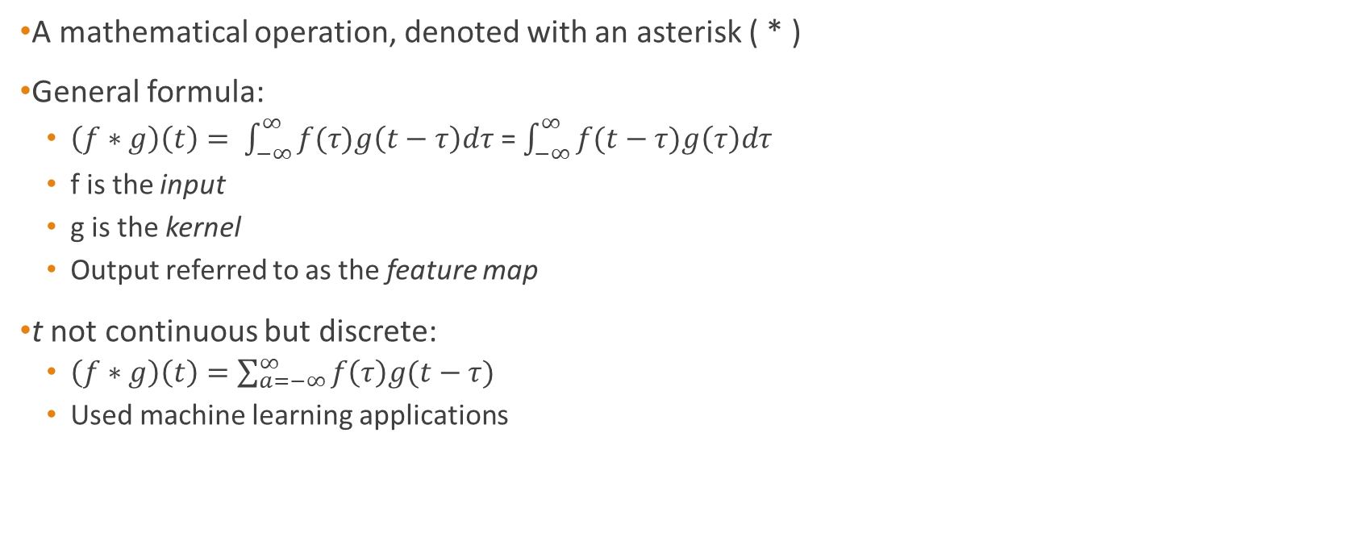
Convolution
A mathematical operation, denoted with an asterisk ( * )
General formula:
$\left(f∗g\right)\left(t\right)= \int_{−∞}^{∞}{f(τ)g\left(t−τ\right)dτ}$ = $\int_{−∞}^{∞}{f(t−τ)g\left(τ\right)dτ}$
f is the input
g is the kernel
Output referred to as the feature map
t not continuous but discrete:
$\left(f∗g\right)\left(t\right)=\sum_{a=−∞}^{∞}{f\left(τ\right)g(t−τ) }$
Used machine learning applications

Slide 4
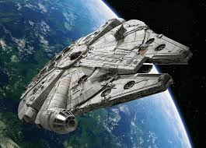
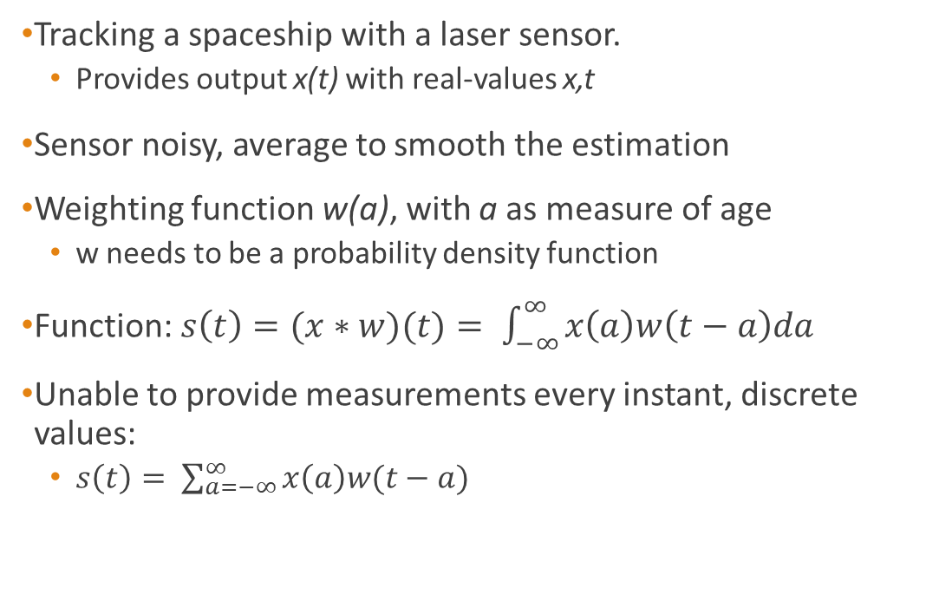
Example of convolution
Tracking a spaceship with a laser sensor.
Provides output x(t) with real-values x,t
Sensor noisy, average to smooth the estimation
Weighting function w(a), with a as measure of age
w needs to be a probability density function
Function: $s\left(t\right)=(x∗w)(t)= \int_{−∞}^{∞}{x\left(a\right)w\left(t−a\right)da}$
Unable to provide measurements every instant, discrete values:
$s\left(t\right)= \sum_{a=−∞}^{∞}{x\left(a\right)w(t−a)}$

Slide 5
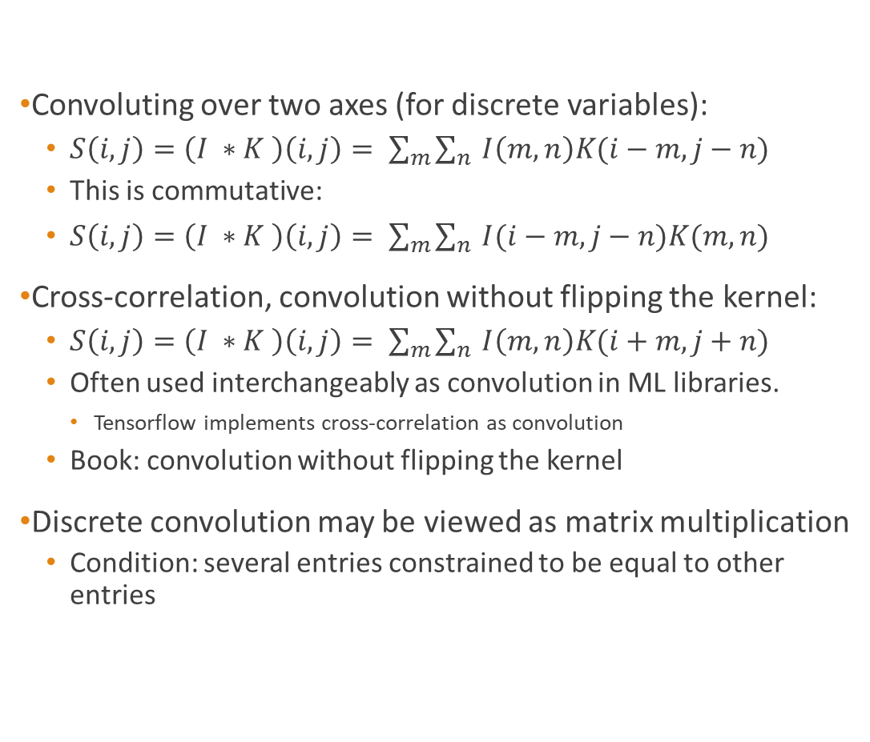
2D convolution
Convoluting over two axes (for discrete variables):
$S\left(i,j\right)=\left(I ∗K \right)\left(i, j\right)= \sum_{m}{\sum_{n}{I\left(m,n\right)K(i−m, j−n)}}$
This is commutative:
$S\left(i,j\right)=\left(I ∗K \right)\left(i, j\right)= \sum_{m}{\sum_{n}{I(i−m, j−n)K(m,n)}}$
Cross-correlation, convolution without flipping the kernel:
$S\left(i,j\right)=\left(I ∗K \right)\left(i, j\right)= \sum_{m}{\sum_{n}{I\left(m,n\right)K(i+m, j+n)}}$
Often used interchangeably as convolution in ML libraries.
Tensorflow implements cross-correlation as convolution
Book: convolution without flipping the kernel
Discrete convolution may be viewed as matrix multiplication
Condition: several entries constrained to be equal to other entries

Slide 6
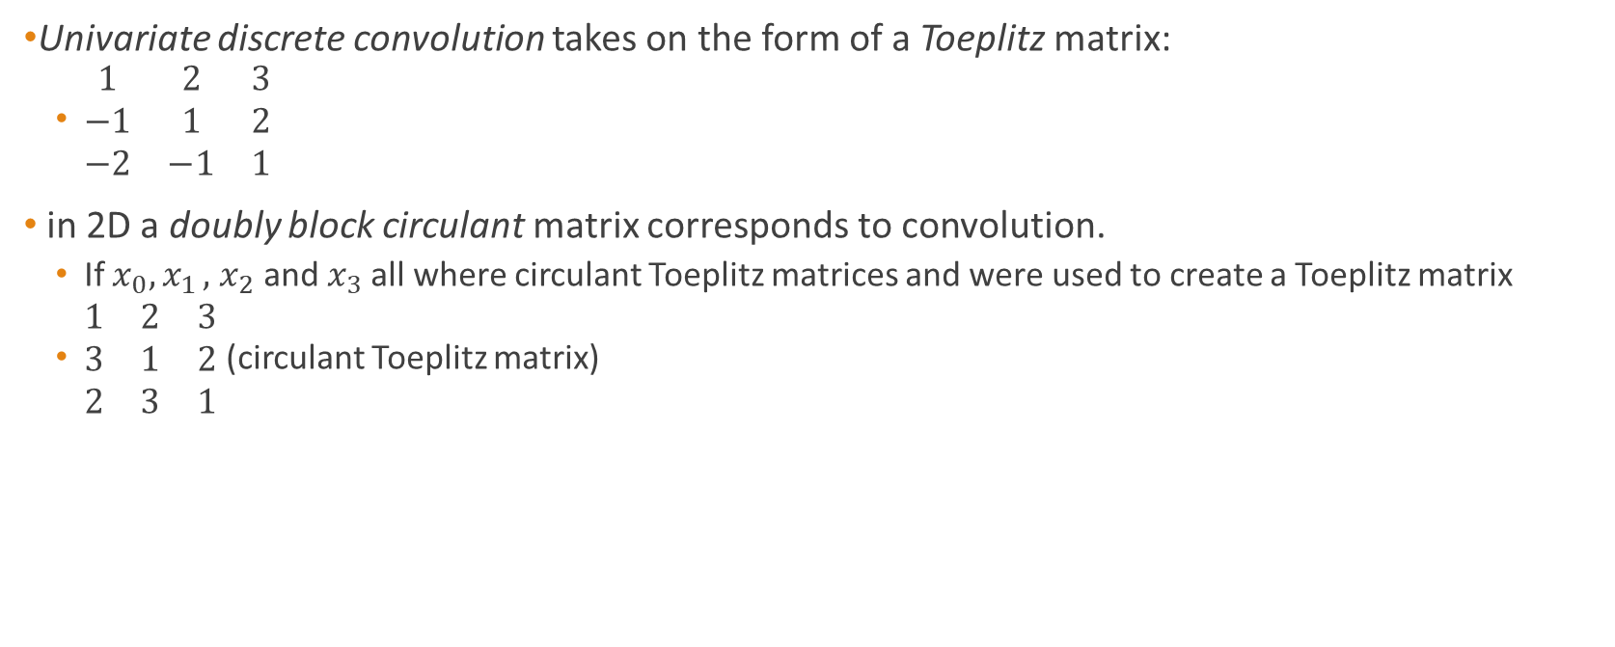
2D convolution (cont.)
Univariate discrete convolution takes on the form of a Toeplitz matrix:
$\begin{matrix}1 & 2 & 3 \\ −1 & 1 & 2 \\ −2 & −1 & 1\end{matrix}$
in 2D a doubly block circulant matrix corresponds to convolution.
If $x_{0}{, x}_{1},$ $x_{2}$ and$x_{3}$ all where circulant Toeplitz matrices and were used to create a Toeplitz matrix
$\begin{matrix}1 & 2 & 3 \\ 3 & 1 & 2 \\ 2 & 3 & 1\end{matrix}$ (circulant Toeplitz matrix)

Slide 7
Why does cNN work?
A convolutional layer typically consists of three stages:
Convolution stage
Detector stage (ReLU)
Pooling stage
Adds 3 important ideas:
Sparse interactions
Parameter sharing
Equivariant representations

Slide 8
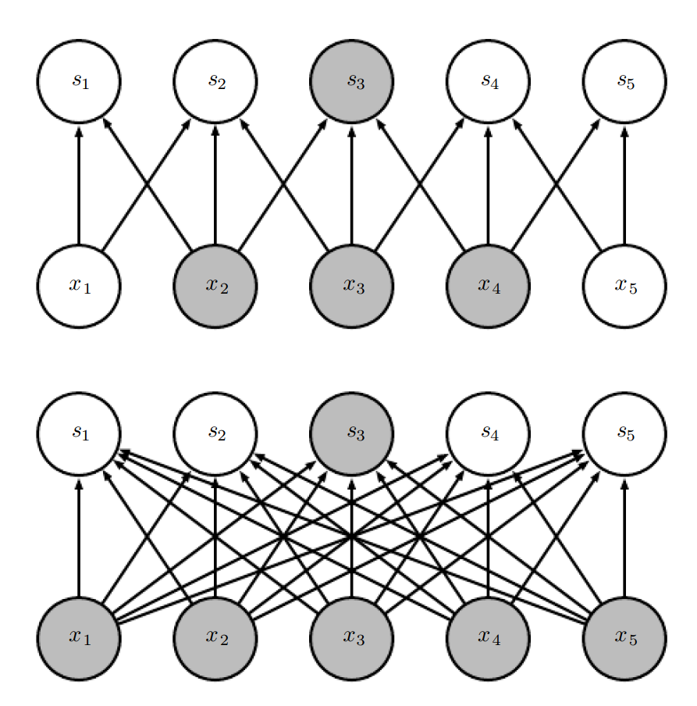
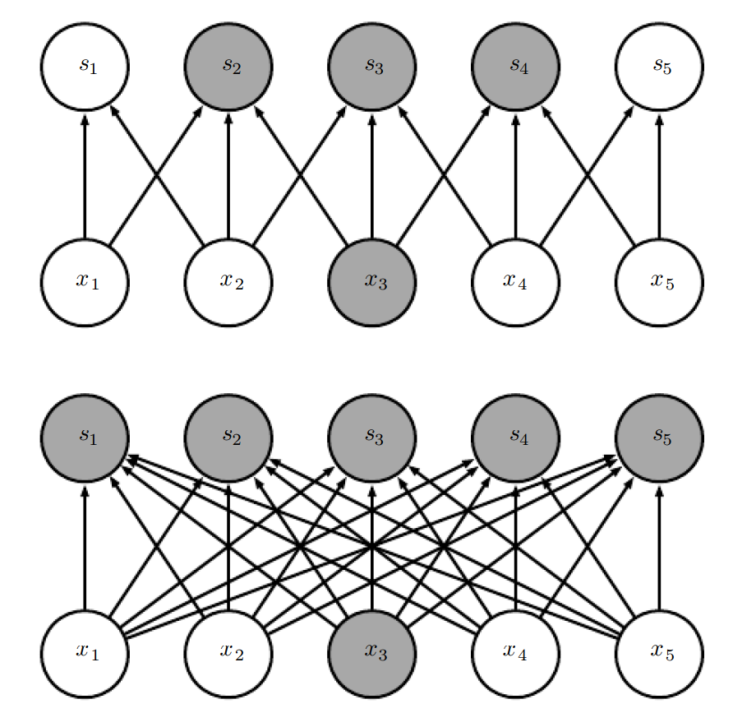

Sparse Interactions
Sometimes called sparse connectivity or sparse weights
kernel smaller than the input
k may be several orders of magnitude less than m
Useful in image processing when looking for specific features such as edges
Stores fewer parameters, reducing memory requirements
Output computed with fewer operations
Usually significant efficiency improvements
Runtime matrix multiplication $O(m×n)$ for m inputs and n outputs
Limiting connections on the output to k yields $O(k×n)$ in runtime

Slide 9
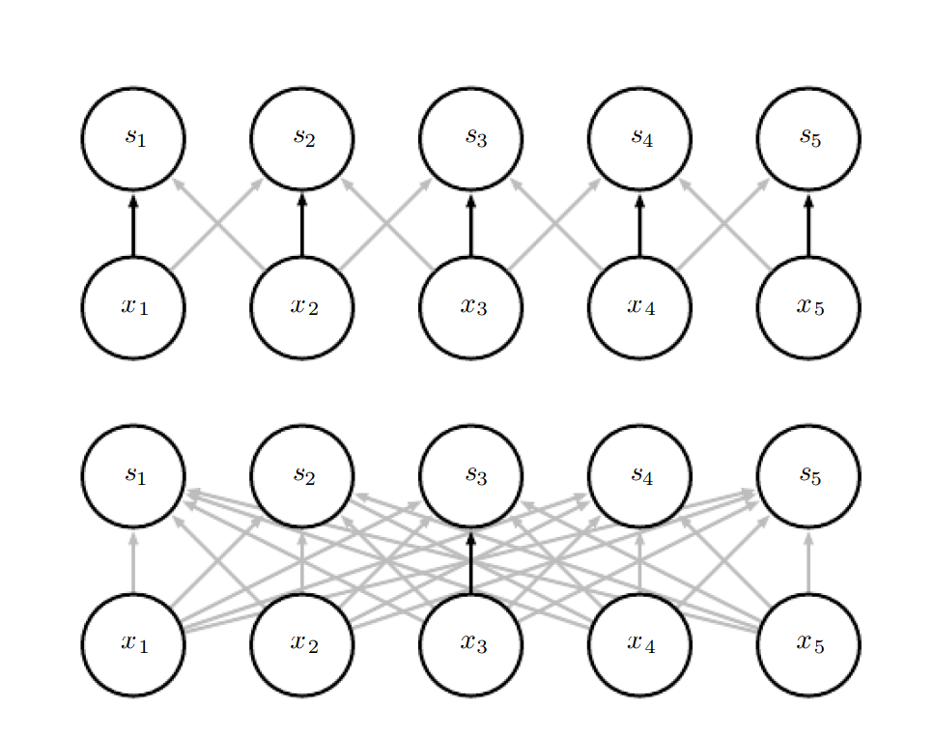
Parameter sharing
When using the same parameter for more than one function one uses parameter sharing
In NN the weight matrix is used once and never revisited
Parameter sharing may be referred to as tied weights
The kernel assures that each of its members is used at every position of the input
Rather than learning a new parameter for every location one set is created and utilized
Does not affect runtime of forward propagation
Reduces storage requirements to k parameters (with k << m)

Slide 10

Equivariance
$f\left(g(x)\right)=g\left(f\left(x\right)\right)$ means function f(x) is equivariant to function g
Caused by the parameter sharing, resulting in changes in the input will change the output in the same way
Useful to generalise f.ex edge texture or shape detection in different locations

Slide 11
Pooling
Used to modify the output of the convolutional layer
Different functions used
Maximum pooling
Average of a rectangular neighbourhood
L² norm of a rectangular neighbourhood
Weighted average based on the distance form the central pixel
Causes invariant representation to small translations
Useful if knowing a feature is present is more important than knowing the exact location
One may pool over spatial regions to produce invariance to translation
or over outputs of separately parametrized convolutions to learn transformations to become invariant to

Slide 12
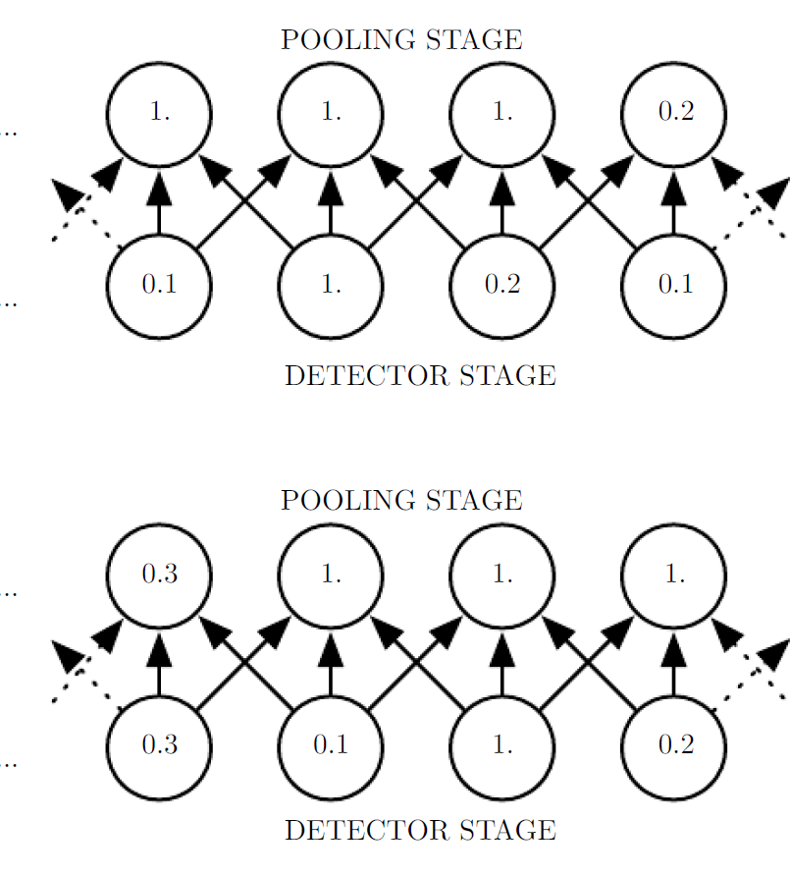
Pooling (cont.)
Number of pooling units may be less than detector units to improve computational efficiency
The output is then a summary statistics for specific pooling regions spaced k pixels apart rather than 1 pixel apart
Useful for handling inputs of varying size
May complicate Boltzmann machines and autoencoders
More discussion on this in ch. 20 exists

Slide 13
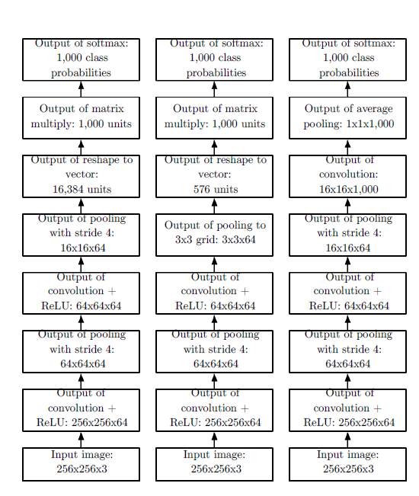

Slide 14
Infinitely Strong Prior
A probability distribution over the parameters of a model that encodes our beliefs about what models are reasonable before having seen data is a prior probability distribution.
Weak prior if the entropy is high (Gaussian with high variance)
Strong prior if the entropy is low (Gaussian with low variance)
Forbid the use of some parameters may result in an infinitely strong prior
A cNN is similar to a fully connected net with infinitely strong prior over the weights
(don't do this, just useful for understanding how cNNs work)

Slide 15
Difference in theory and practicum
One feature in many locations against many features in many locations
3D or 4D input/output for 2D signals
Multi-channel convolution
Not necessarily commutative, even with kernel-flipping
Notes:
In mathematical literature convolution is slightly different than in the practical context of neural nets.
Instead of a single kernel extracting one feature at many spatial locations, we want several convolution applications running in parallel, extracting many features in many locations.
To support the different spacial coordinates of each channel a convolution of a 2D signal is often using 3D tensors as input and output. If we in addition take the batches into consideration we are talking of 4D with batch examples presenting the 4th axis
As cNN usually use multi-channel convolution, the linear operations are not guaranteed to be commutative, even with kernel-flipping

Slide 16
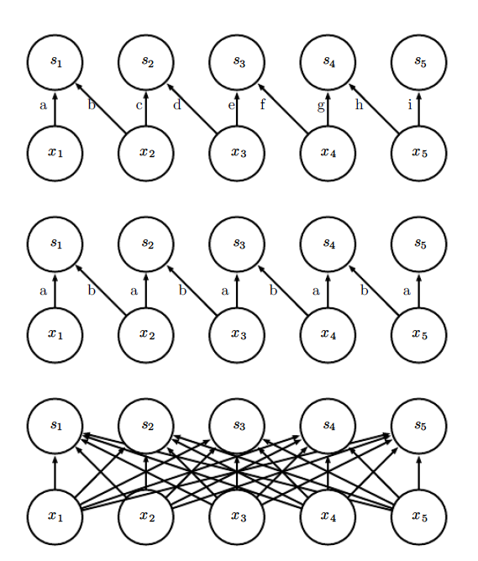
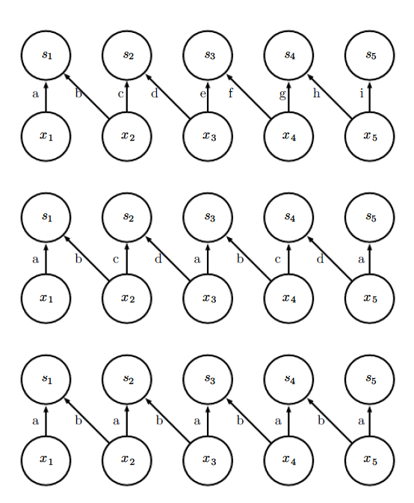
Variations
Downsampling
Zero padding
Valid (shrinking)
Same
Full (growing)
The implementation of this may be different depending on library!
Locally connected layers (unshared convolution)
Tiled convolution
Notes:
Skipping over some positions of kernel to reduce computational cost
- this may result in less fine feature extractions
This is often called downsampling, with a variable s. S represents the values we want to sample, and tells us the amount of values dropped before one is chosen
To control the size of the output independently of the kernel size we use zero padding. Zero padding allows us to choose large kernels without shrinking the spatial extent of the network rapidly.
With valid padding the output is expected to be shrinking.
In MATLAB the valid padding is not adding any values and only allowing the kernel to visit positions where the entire kernel is contained entirely within the image. /// see book for this
The implementation used by Tensorflow on the other hand valid padding adds some zeros /// see url: https://www.tensorflow.org/versions/r1.0/api_guides/python/nn#Convolution
Same zero padding is used to obtain an output of the same size as the input and the amount of padding is calculated from this intention.
This is usually the same implementation independent of the library
Full zero padding is the extreme case of adding the kernel direction size to the matrix direction size (and then subtracting 1). This results in the output values at the corners only being the function of one input value and other border values will be similarly underrepresented.
Optimal padding usually lies between «valid» and «same»
An alternative to convolution may be locally connected layers (sometimes called unshared convolution). Then every connection has its own weight, represented by a 6D tensor.
The tensor have dimensions output channel, output row, output column, input channel, row offset within the input, column offset within the input.
Called unshared convolution due to the similarity to a discrete convolution with a small kernel but without parameter sharing
Useful when we know that each feature should be a function of a small space, with no reason suggest the feature occur across all of space. F.ex if you are looking for a face, the mouth is logically on the bottom half.
Represents a compromise between a convolutional layer and a locally connected layer. Instead we use a set of kernels rotated trough as we move through space. Different filters for immediately neighbours but reduced memory requirements.
Both unshared convolutional and tiled convolutional layers interact in an intersesting way with max pooling, maybe causing them to become invariant to learned transformations
First image:
Locally connected layer, convolutional layer with kernel width of two pixels, fully connected layer.
2nd image:
Locally connected layer, tiled convolution, «traditional» convolution

Slide 17
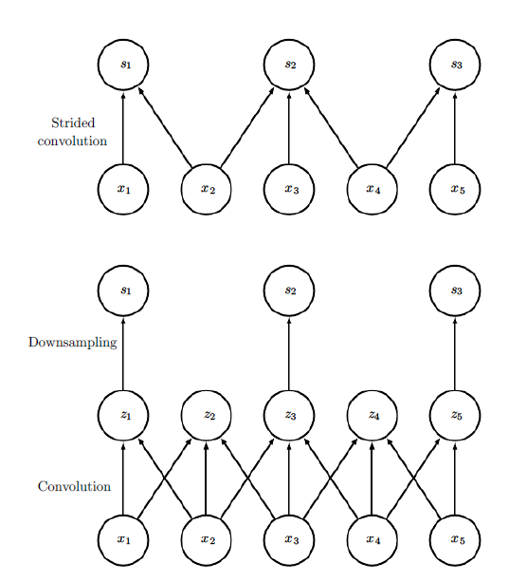
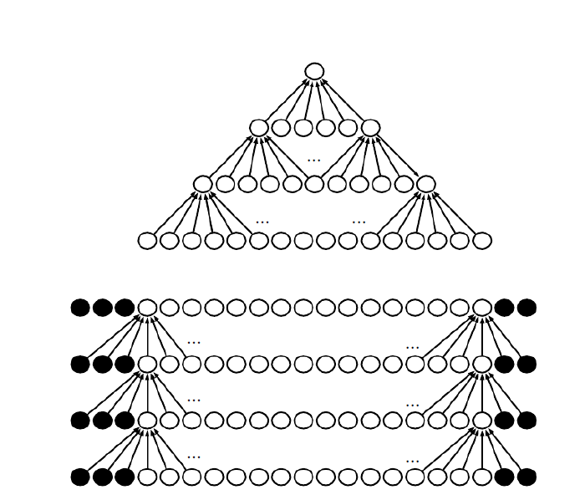
Example of downsampling
“valid” and “same” type zero padding in MATLAB

Slide 18
Necessary operations
Convolution
Backprop from the output weights
Backprop from output to inputs

Slide 19
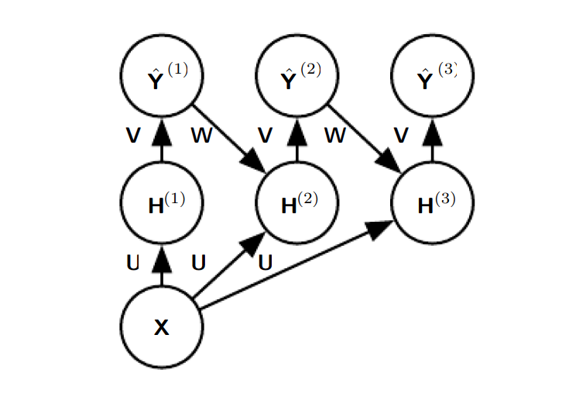
Outputs
cNN may output high-dimensional structured objects rather than just predicting a class
Typically a tensor
Sometimes output plane is of a lower level than the input plane
Pooling with a large stride
One may recurrently guess the class of the output based on neighbouring values

Slide 20
Data types
cNNs may process inputs with varying spatial extents and over several channels
Applying a fixed size weight matrix to models with varying spatial extents may be difficult
This is simple for convolutional networks
Variable size inputs only make sense if the observation is of the same thing!
Notes:
Book uses image example where images differ in width and height

Slide 21
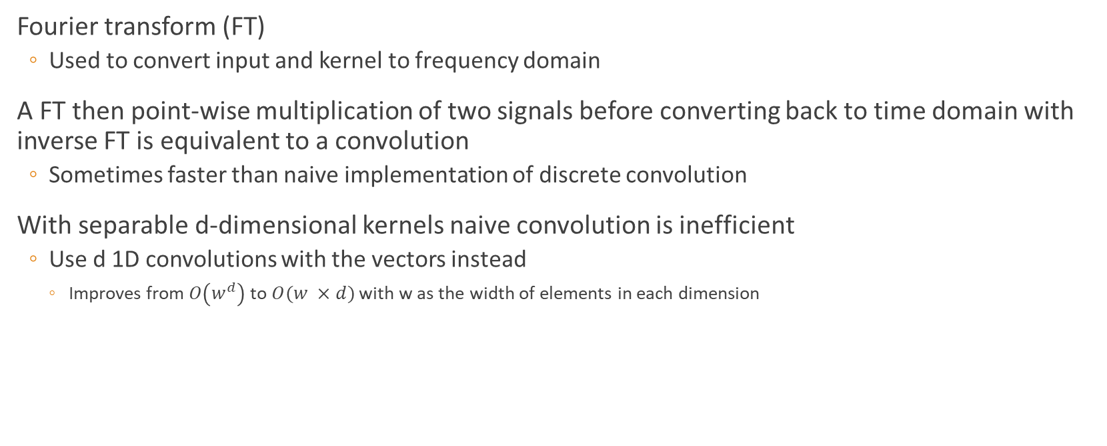
Algorithms
Fourier transform (FT)
Used to convert input and kernel to frequency domain
A FT then point-wise multiplication of two signals before converting back to time domain with inverse FT is equivalent to a convolution
Sometimes faster than naive implementation of discrete convolution
With separable d-dimensional kernels naive convolution is inefficient
Use d 1D convolutions with the vectors instead
Improves from $O\left(w^{d}\right)$ to $O(w ×d)$ with w as the width of elements in each dimension

Slide 22
Features, random and unsupervised
Typically most expensive part of cNN training: feature learning
Unsupervised features better than supervised
3 strategies for obtaining kernels without supervised training
Random initialization
Hand designed features
Unsupervised criterion
Last layer often a convex optimization problem
Assuming logistic regression or an SVM
One may use methods that does not require full forward and back-propagation at all the gradient steps
Use greedy layer-wise pretraining

Slide 23
Basis for convolutional networks
Biologically inspired AI
Key design principles from neuroscience
Book presents a simplified view focused on V1 (the primary visual cortex)
Three properties of V1 used:
Arranged in a spatial map
Contains many simple cells. In cNNs the detector units
Contains many complex cells. In cNNs the pooling units
Neuroscience have relative little influence on how we train cNNs
Simple cells are roughly linear and selective for certain features, complex cells nonlinear and invariant to some transformations
Reverse correlation used to obtain approximation of weights

Slide 24
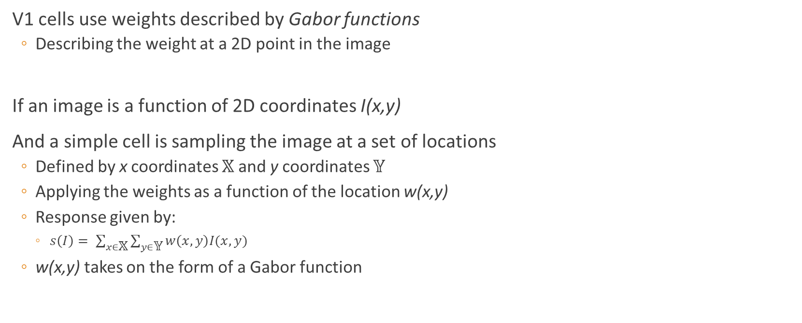
Basis (cont.)
V1 cells use weights described by Gabor functions
Describing the weight at a 2D point in the image
If an image is a function of 2D coordinates I(x,y)
And a simple cell is sampling the image at a set of locations
Defined by x coordinates 𝕏 and y coordinates 𝕐
Applying the weights as a function of the location w(x,y)
Response given by:
$s\left(I\right)= \sum_{x∈\text{𝕏}}{\sum_{y∈\text{𝕐}}{w\left(x,y\right)I(x,y)}}$
w(x,y) takes on the form of a Gabor function

Slide 25

Gabor function
$w\left(x,y;α,β_{x}{,β}_{y},f,φ, x_{0},y_{0}, τ\right)= α\exp\left(−β_{x}{x′}^{2}−β_{y}{y′}^{2}\right)cos⁡(fx^{′}+ φ)$ where
$x^{′}=\left(x − x_{0}\right)\cos\left(τ\right)+\left(y −y_{0}\right)\sin\left(τ\right)$
$y^{′}=−\left(x − x_{0}\right)\sin\left(τ\right)+\left(y − y_{0}\right)\cos\left(τ\right)$
x₀, y₀ and τ define a coordinate system
Translate and rotate x and y to form x’ and y’

Slide 26
History
cNNs have an important role in deep learning history
Example of successful application of insight from neuroscience
First models to:
perform well
solve important commercial applications
Specializes in working with grid-structure topology
Especially successful in two-dimensional image topology

